Slide 1
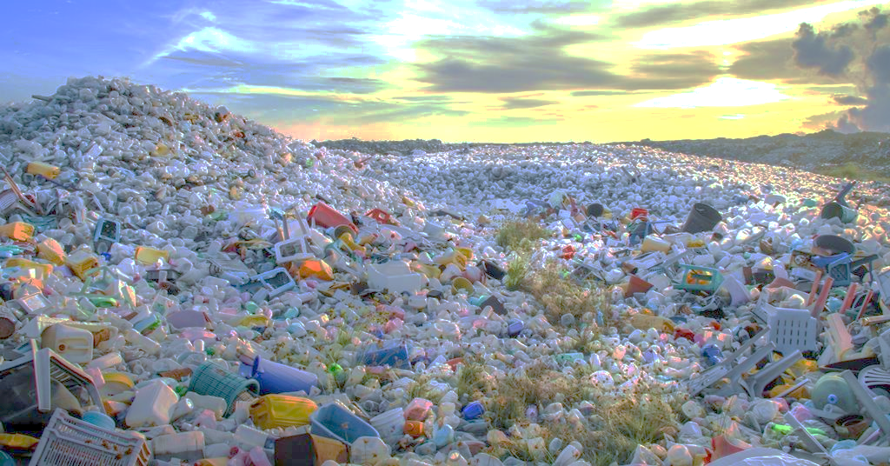
PLASTI-LESS A STEP TOWARDS SUSTAINABLE FUTURE…!!
Mentor:- Dr. Alok Dabade Sir.
Pruthvi Patane
Dharati Patil
Ashwini Dahiphale
Mayuri Khanvilkar

Slide 2

Introduction
Thousands of plastic factories are producing tons of plastic products which are very popularly used by the people for different purposes because of its ease, cheapness and convenience of use but their very hazardous negative impact is never highlighted or, at the very least, openly discussed in a more serious tone. We investigate the impact of a plastic ban and it’s effectiveness based on a field survey carried out among consumers and retailers across selected areas.

Slide 3
Aim
To identify the issues encountered in the plastic ban & provide solutions to tackle it.

Slide 4
Objectives
To study the effect of socio-economic factors on use of plastic bag.
To check the association between socio-economic factor and usage of plastic.
To study the change in opinion of people about usage of plastic before and after ban.
To check whether the people are aware about banned products & harmful effects of plastic.
To understand the thoughts of people about role of Government in plastic ban from Consumers point of view.
To check simple & most affordable alternatives of plastic bags.
To check the association between Type of shop and providing plastic bags.

Slide 5
Variables
Response Variables
Customer
Usage of plastic.
Opinion of people(Pre-Post).
Customer thoughts on Government Role.
Medium of information
Inclination towards alternatives.
Shopkeeper
Loss in business.
Expense on plastic products & alternatives.
Thoughts on alternatives of plastic products.
Explanatory Variables
Age
Gender
Occupation
Area of residence
Family Income
Type of residence

Slide 6
Data collection
We collected primary data by preparing a questionnaire.
We formed a separate questionnaire among consumers and retailers using google form.
We conducted a pilot survey of 20 people.
Since we didn’t face any difficulties in pilot survey, so we continued with same questionnaire to collect the data.
we collected 400 no. of Consumers & 75 no. of Retailers.
We have used the Two Stage Sampling Technique for data collection

Slide 7
METHODOLOGY
Preparatory Phase
Pilot Study
Designing The Questionnaire
Actual Survey
Data Cleaning
Coding Of Data
Analysis Of Data
Interpretation Of Data
Conclusion

Slide 8
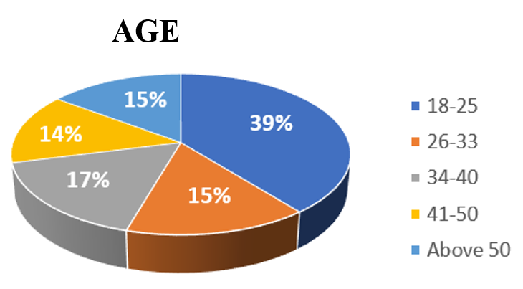
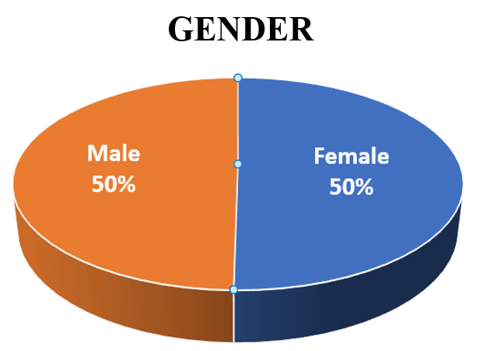
DATA VISUALIZATION

Slide 9
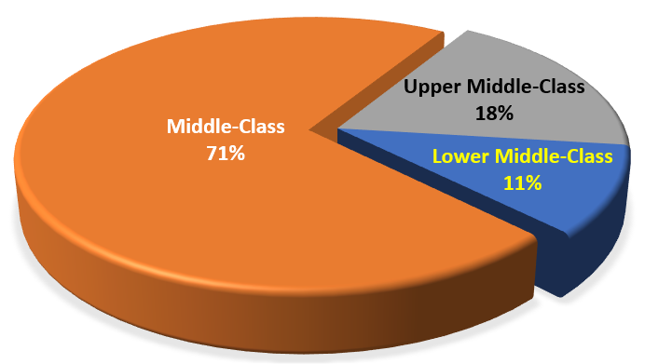
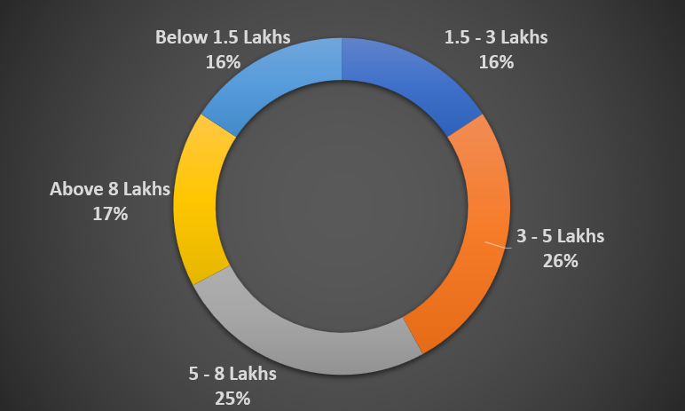
Area
Annual Family Income

Slide 10
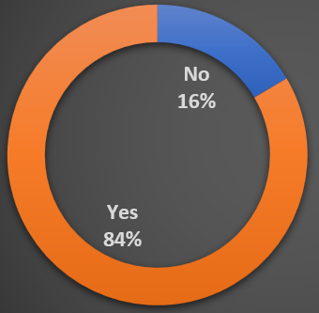
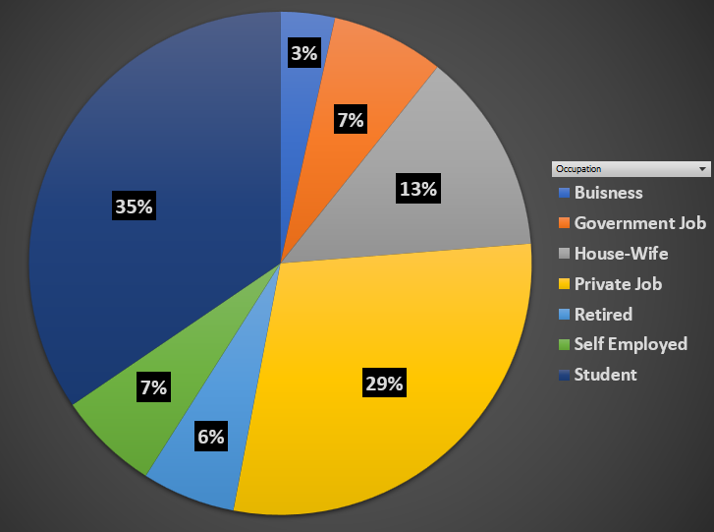
Support To Plastic Ban
Occupation

Slide 11
OBJECTIVE-1: To study the effect of socio-economic factors on use of plastic.
H₀: The usage of plastic & socio-economic factors are independent.
H₁: The usage of plastic & socio-economic factors are dependent.
By using Multinomial Logistic Regression to test the hypothesis.

Slide 12
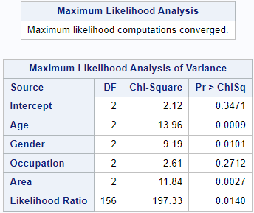
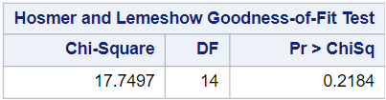
Multinomial Logistic regression
⸪ There is no strong evidence to suggest a lack-of-fit in the Multinomial Logistic Model based on the Hosmer & Lemeshow Test hence, the Multinomial Logistic Regression fits the expected data well.
⸪ P-value of Age, Gender and Area are <0.05
⸫ Age, Gender and Area are significant

Slide 13
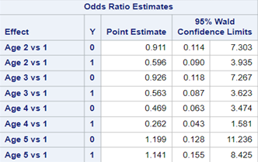
Odds Ratio
For Age:
The odds of category No with reference category Yes for customer with Age group 26-33 is estimated to be 0.911 with reference Age group 18-25.
∴ A customer with Age 26-33 is less likely to not use plastic bag as compared to Age 18-25.
The odds of category Maybe with reference category Yes for customer with Age group 26-33 is estimated to be 0.596 with reference Age group 18-25.
∴ A customer with Age 26-33 is less likely to sometimes use plastic bag as compared to Age 18-25.

Slide 14


For Gender:
The odds of category No with reference category Yes for Females is estimated to be 1.068 with reference to Males.
∴ Females are more likely to not use plastic bag as compared to Males.
The odds of category Maybe with reference category Yes for Females is estimated to be 2.466 with reference to Males.
∴ Females are more likely to sometimes use plastic bag as compared to Males.

Slide 15
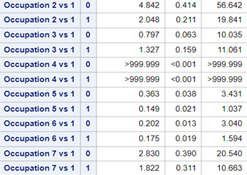
For Occupation:
The odds of category No with reference category Yes for the Self-Employed persons is estimated to be 4.842 with reference to Students.
∴ The Self-Employed persons are more likely to not use plastic bag as compared to Students.
The odds of category Maybe with reference category Yes for the Self-Employed persons is estimated to be 2.048 with reference to Students.
∴ The Self-Employed persons are more likely to sometimes use plastic bag as compared to Students.

Slide 16

For Area:
The odds of category No with reference category Yes for Middle-Class People is estimated to be 3.23 with reference to Lower Middle-Class People.
∴ Middle-Class People are more likely to not use plastic bag as compared to Lower Middle-Class People.
The odds of category Maybe with reference category Yes for Middle-Class People is estimated to be 3.83 with reference to Lower Middle-Class People.
∴ Middle-Class People are more likely to sometimes use plastic bag as compared to Lower Middle-Class People.

Slide 17
OBJECTIVE-2: To check the association between socio-economic factor and usage of plastic.
Hypothesis:
H₀: There is no association between the usage of plastic & socio-economic factors.
H₁: There is association between the usage of plastic & socio-economic factors.
By using Pearson’s χ² – Test of Association.

Slide 18
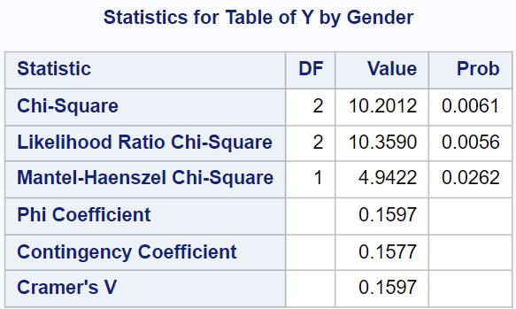
To test the association between Gender & Usage of plastic. H₀₁: There is no association between the usage of plastic & gender. H₁₁: There is association between the usage of plastic & gender.
Since P-value = 0.0061 < 0.05
Therefore we reject null hypothesis and conclude that, there is association between usage of plastic and gender.
Cramer's V is a measure of association calculated as 0.1597, which is the same as the Phi coefficient suggests that a positive association between gender & usage of plastic.

Slide 19

To test the association between Age & Usage of plastic. H₀₂: There is no association between the usage of plastic & age. H₁₂: There is association between the usage of plastic & age.
Since P-value < 0.0001 < 0.05
Therefore we reject null hypothesis and conclude that, there is association between usage of plastic and Age
Cramer's V is a measure of association calculated as 0.2223 suggests that a positive association between age & usage of plastic.

Slide 20
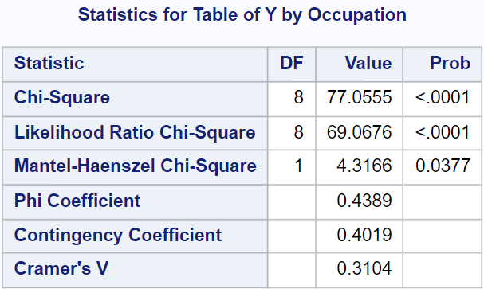
To test the association between Occupation & Usage of plastic. H₀₃: There is no association between the usage of plastic & occupation. H₁₃: There is association between the usage of plastic & occupation.
Since P-value < 0.0001 < 0.05
Therefore we reject null hypothesis and conclude that, there is association between usage of plastic and Occupation
Cramer's V is a measure of association calculated as 0.3104 suggests that a positive association between occupation & usage of plastic.

Slide 21
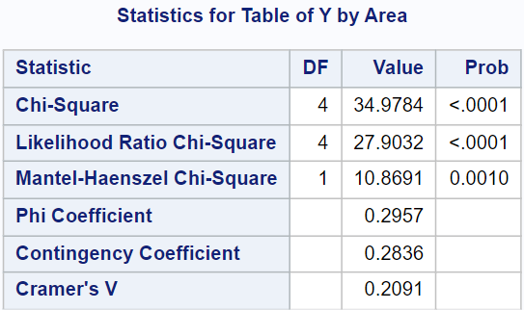
To test the association between Area & Usage of plastic. H₀₄: There is no association between the usage of plastic & area. H₁₄: There is association between the usage of plastic & area.
Since P-value < 0.0001 < 0.05
Therefore we reject null hypothesis and conclude that, there is association between usage of plastic and Area.
Cramer's V is a measure of association calculated as 0.2091 suggests that positive association between residential area & usage of plastic.

Slide 22
OBJECTIVE-3: To study the change in opinion of people about plastic before and after ban
Shopkeeper not giving plastic bag.
Using reusable bags at Grocery/Vegetable store.
Carrying your own bag(except plastic) for clothes shopping.
Using plastic products while travelling.
Using plastic products in occasion or function.
Pre-Ban X1,X2,X3,X4,X5
Post-Ban Y1,Y2,Y3,Y4,Y5

Slide 23
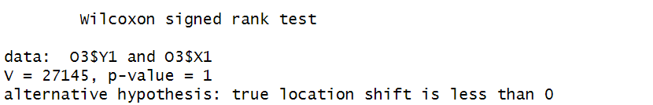
H₀₁: There is no change in providing plastic bag by shopkeeper after ban. H₁₁: There is reduction in providing plastic bag by shopkeeper after ban.
∵ P-value = 1 > 0.05
∴ We do not reject null hypothesis and conclude that, there is no change in providing plastic bag by shopkeeper after ban.

Slide 24
Similarly for Remaining Situations,
SITUATION | P-Value | Conclusion
Using Reusable bag at grocery/vegetable store | 1 | Since P-value =1 > 0.05 So we do not reject null hypothesis and conclude that there is no change in usage of Reusable bag at grocery/vegetable store after ban.
Carrying their own bag(except plastic) for clothes shopping | 1 | Since P-value =1 > 0.05 So we do not reject null hypothesis and conclude that there is no change in people Carrying their own bag(except plastic) for clothes shopping after ban
Using plastic product while Travelling | 8.219e-16 | Since P-value =8.219e-16 < 0.05 So we reject null hypothesis and conclude that there is reduction in the usage of plastic product while travelling
Using plastic products in occasions or function | 2.2e-16 | Since P-value =2.2e-16 < 0.05 So we reject null hypothesis and conclude that there is reduction in the usage of plastic product in occasions or function

Slide 25
OBJECTIVE-4: To check whether the people are aware about banned products & harmful effects of plastic.
Social Problems:
Blockage of sewage & dumping issues.
Effect on marine & death of livestock.
Cause of cancer, skin and respiratory problem.
Recycling problem.
Deteriorating beauty of tourist places.

Slide 26
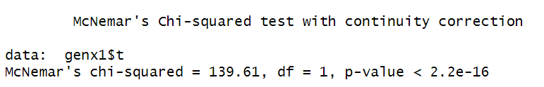
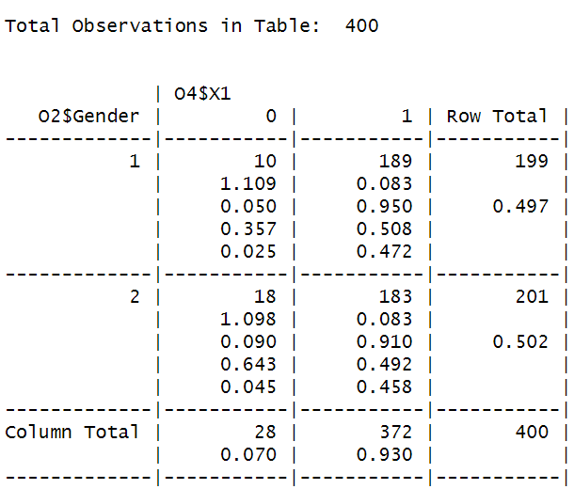
H₀₁: The proportion of awareness about blockage of sewage & dumping issues in males and females is equal. H₁₁: The proportion of awareness about blockage of sewage & dumping issues in males and females is not equal.
From McNemar test,
Since P-value = 2.2e-16 < 0.05
∴ We reject the null hypothesis and conclude that, proportion of awareness about blockage of sewage & dumping issues in males and females is not equal.
From proportionality table we can conclude that, 95% of males & 91% of females are aware.

Slide 27
Similarly, for the remaining situations,
Social Problems | McNemar P-value | Conclusion | Percent Aware males | Percent Aware females
Effect on Marine / Death of Livestock | 2.2e-16 | ⸪ P-value = 2.2e-16 < 0.05 ⸫We reject null hypothesis and conclude that proportion of awareness about Effect on Marine/Death of Livestock due to consumption of plastic in males and females is not equal. | 87.4% | 76.6%
Causes Cancer/Skin/ Respiratory problems | 3.619e-05 | ⸪ P-value = 3.619e-05 < 0.05 ⸫We reject null hypothesis and conclude that proportion of awareness about Causes Cancer/Skin/ Respiratory problems in males and females is not equal. | 68.3% | 62.7%
Recycling Problems | 4.809e-13 | ⸪ P-value = 4.809e-05 < 0.05 ⸫We reject null hypothesis and conclude that proportion of awareness about Recycling Problems in males and females is not equal. | 75.9% | 76.1%
Deteriorating beauty of tourist places | 2.2e-16 | ⸪ P-value = 2.2e-16 < 0.05 ⸫We reject null hypothesis and conclude that proportion of awareness about Deteriorating beauty of tourist places in males and females is not equal. | 90.5% | 85.1%

Slide 28
OBJECTIVE-5: To understand the thoughts of people about role of Government in plastic ban from Costomers point of view.

Slide 30
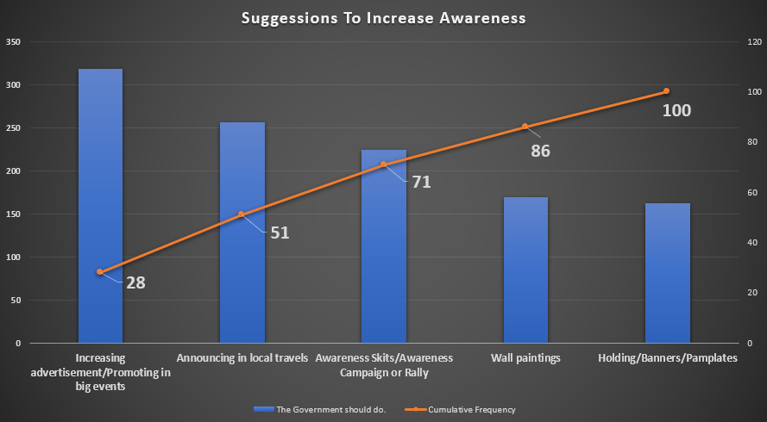

Slide 31
OBJECTIVE-6: To check simple & most affordable alternatives of plastic bags.

Slide 34
OBJECTIVE-7: To check if there is association between type of shop and providing Plastic bag.
Hypothesis:
H₀: There is no association between Type of shop and providing plastic bags. H₁: There is association between Type of shop and providing plastic bags.
By using χ² – Test of Association,

Slide 35
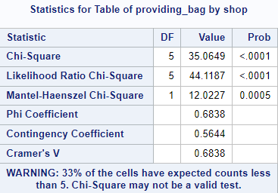
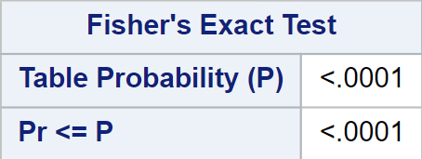
∵ The expected count value of 33% of the cells of contingency table are less than 5 in the shopkeeper data.
∴ The Chi-Square test may not be valid in this case
∵ P-value <.0001 we reject null hypothesis and conclude that there is association between type of shop and providing plastic bag.

Slide 36
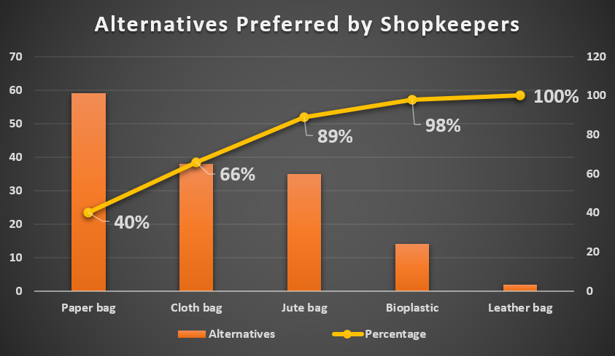
Pareto Analysis for Alternatives Preferred by Shopkeepers:

Slide 37
Frequency Graph for Additional Amount Ready to Spend by Shopkeeper:

Slide 38
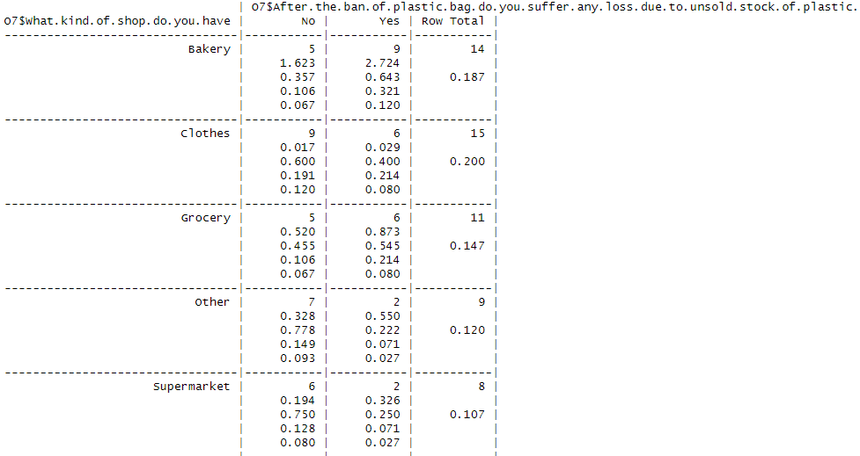

From proportionality analysis we can conclude that due to plastic ban the bakery shops has suffered excess loss 64.3%. and the least loss is suffered by vegetable store 16.7% due to unsold stock of plastic.

Slide 39
conclusion
The socio-economic factors like Age, Gender & Area have a huge impact on the amount of plastic usage and effectiveness of plastic ban also occupation has some positive association with usage of plastic.
After ban, The provision of plastic bags by retailers is not reduced i.e., they are still using the plastic as like before & the customers use the reusable bags at grocery or vegetable stores & for clothing shopping.
Whereas, after banning plastic there is reduction in usage of plastic products by people while travelling or in occasions & functions.
People are getting aware about problems caused by plastic waste like death of livestock’s, blockage of sewage, damage caused to marine life, the causes of cancer disease.
Most of the people are using cloth or paper bags as an alternative to plastic also the access of people are ready to spend at the most 10-20 rupee additional for alternatives. Also, some of the people don’t use alternatives because its purchase cost, availability and comfortness.
The most preferred alternatives by the retailers are paper and cloth bags over plastic bag & average additional amount retailers are ready to spend for alternatives is 10 rupees.

Slide 40
Scope & Suggestion's
We can extend this survey to different regions of Maharashtra and can check the effectiveness of the ban and give more suggestions to improve the implementation of ban.
To implement the ban more effectively Government should provide alternatives for plastic in low price, buyback scheme for plastic bottles, take strict actions against manufacturers.
Government with the help of Environmental agencies and NGOs need to take initiatives like educate people from rural areas & slums about awareness & increase the frequency of advertisements on different medium. Also, Government can engage a popular face for campaigns such as ‘GO PLASTIC FREE’.
According to us, the perceptions of plastic bags need to be removed completely from our society. An initiative should be taken by us. Unless the change is brought in us, movement taken by Government will not be successful.

Slide 41

Thank You

